Slide 1
4
INTEGRALS

Slide 2
4.3
Evaluating Definite Integrals

Slide 3

Evaluating Definite Integrals
Sir Isaac Newton and Leibniz realized that they could calculate f(x)dx if they happened to know an antiderivative F of f. Their discovery, called the Evaluation Theorem, is part of the Fundamental Theorem of Calculus.

Slide 4
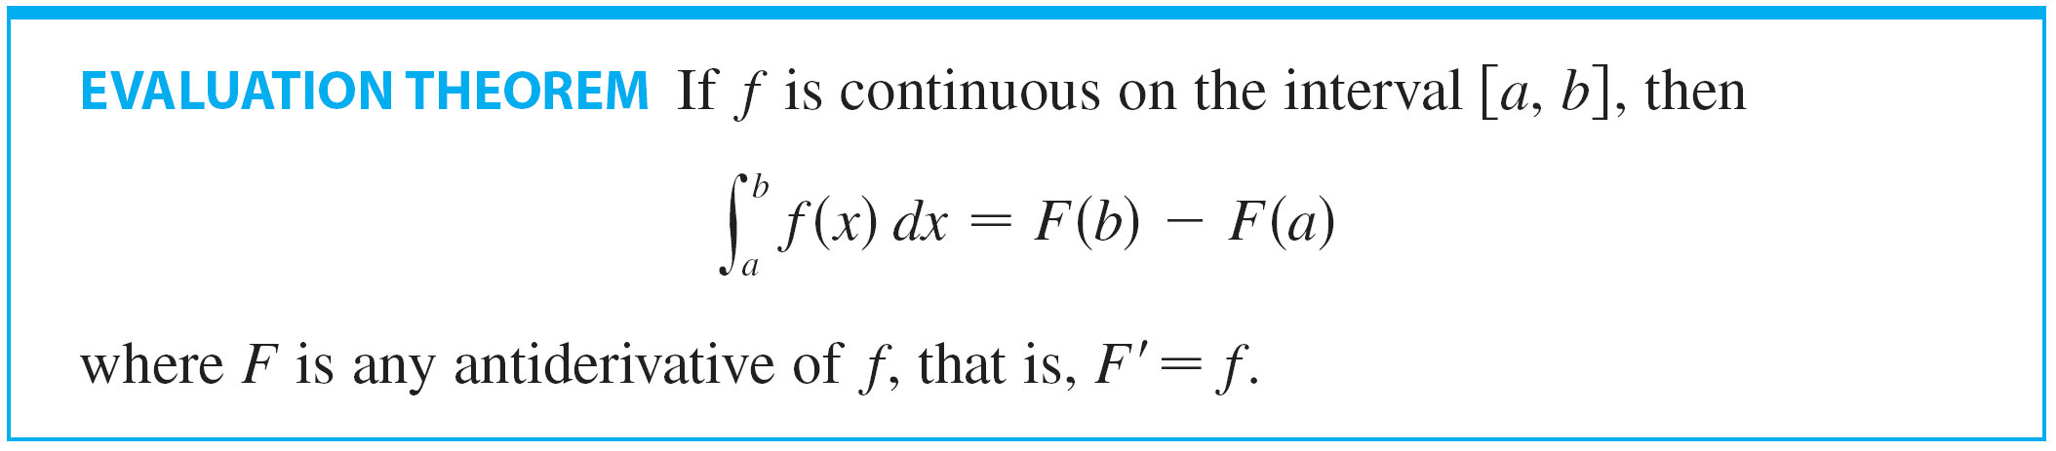
Evaluating Definite Integrals
The Evaluation Theorem is as follows:
This theorem states that if we know an antiderivative F of f, then we can evaluate f (x) dx simply by subtracting the values of F at the endpoints of the interval [a, b].

Slide 5
Evaluating Definite Integrals
It is very surprising that f (x) dx, which was defined by a complicated procedure involving all of the values of f (x) for a ≤ x ≤ b, can be found by knowing the values of F(x) at only two points, a and b.

Slide 6
EVALUATION THEOREM
For instance,
We know from Section 3.7 that an antiderivative of f(x) = x2 is F(x) = 1/3x3, so the Evaluation Theorem tells us that
Comparing this method with the calculation in Example 2 in Section 4.1, where we found the area under the parabola f(x) = x2 from 0 to 1 by computing a limit of sums, we see that the Evaluation Theorem provides us with a simple and powerful method.

Slide 7
EVALUATION THEOREM
Although the Evaluation Theorem may be surprising at first glance, it becomes plausible if we interpret it in physical terms.
If v(t) is the velocity of an object and s(t) is its position at time t, then v(t) = s’(t) , so s is an antiderivative of v.

Slide 8
EVALUATION THEOREM
In Section 4.1 we considered an object that always moves in the positive direction and made the guess that the area under the velocity curve is equal to the distance traveled. In symbols:
That is exactly what the Evaluation Theorem says in this context.

Slide 9
PROOF OF THE EVALUATION THEOREM
We divide the interval [a, b] into subintervals with endpoints x₀(= a), x₁, x₂, …, x_{n}(= b) and with length ∆x = (b – a)/n.
Let F be any antiderivative of f.
By subtracting and adding like terms, we can express the total difference in the F values as the sum of the differences over the subintervals:

Slide 10
PROOF OF THE EVALUATION THEOREM
Now F is continuous (because it’s differentiable) and so we can apply the Mean Value Theorem to F on each subinterval [x_{i – 1}, x_{i}].
Thus
There exists a number x_{i}* between x_{i – 1} and x_{i} such that
Therefore

Slide 11
PROOF OF THE EVALUATION THEOREM
Now we take the limit of each side of this equation as n → ∞.
The left side is a constant and the right side is a Riemann sum for the function f, so

Slide 12
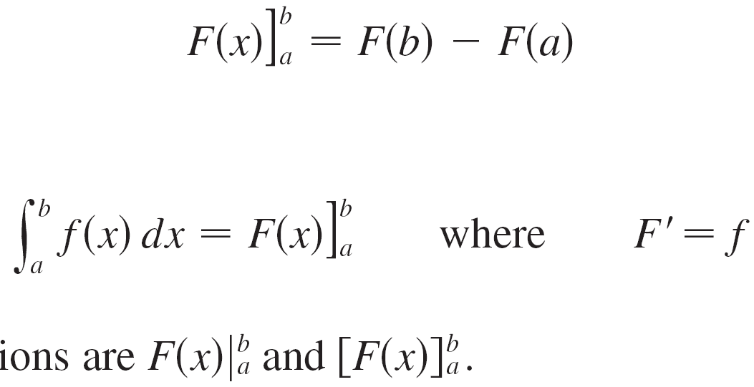
Evaluating Definite Integrals
When applying the Evaluation Theorem we use the notation
and so we can write
where
Other common notations are and .

Slide 13
Example 1
Evaluate
SOLUTION
An antiderivative of f(x) = x³ is F(x) = 1/4x⁴.
We use the Evaluation Theorem as follows:

Slide 14
Example 2
Find the area under the cosine curve from 0 to b, where 0 ≤ b ≤ π /2.

Slide 15
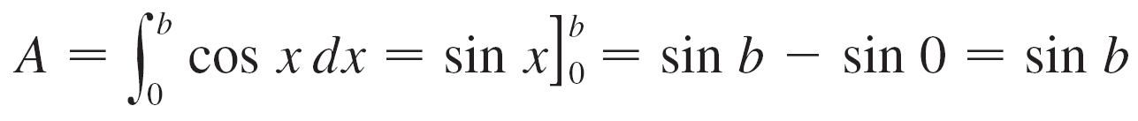
Example 2 – Solution
SOLUTION:
Since an antiderivative of is we have

Slide 16
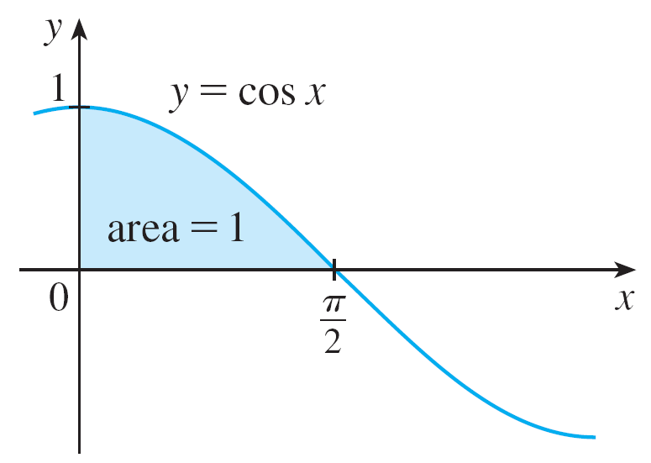
Example 2 – Solution
cont’d
In particular, taking b = π /2, we have proved that the area under the cosine curve from 0 to π /2 is sin(π /2) = 1.
(See Figure 1.)
Figure 1

Slide 17
EVALUATION THEOREM
When the French mathematician Gilles de Roberval first found the area under the sine and cosine curves in 1635, this was a very challenging problem that required a great deal of ingenuity.
If we didn’t have the benefit of the Evaluation Theorem, we would have to compute a difficult limit of sums using obscure trigonometric identities (or a computer algebra system as in Exercise19 in Section 4.1).

Slide 18
EVALUATION THEOREM
It was even more difficult for Roberval because the apparatus of limits had not been invented in 1635.
But in the 1660s and 1670s, when the Evaluation Theorem was discovered by Newton and Leibniz, such problems became very easy, as you can see from Example 2.

Slide 19
INDEFINITE INTEGRALS
We need a convenient notation for antiderivatives that makes them easy to work with.

Slide 20
Indefinite Integrals

Slide 21
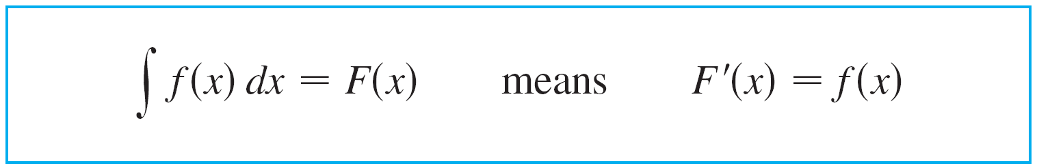
Indefinite Integrals
The notation f (x) dx is traditionally used for an antiderivative of f and is called an indefinite integral.
Thus
An indefinite integral f (x) dx can represent either a particular antiderivative of f or an entire family of antiderivatives (one for each value of the constant C).

Slide 22
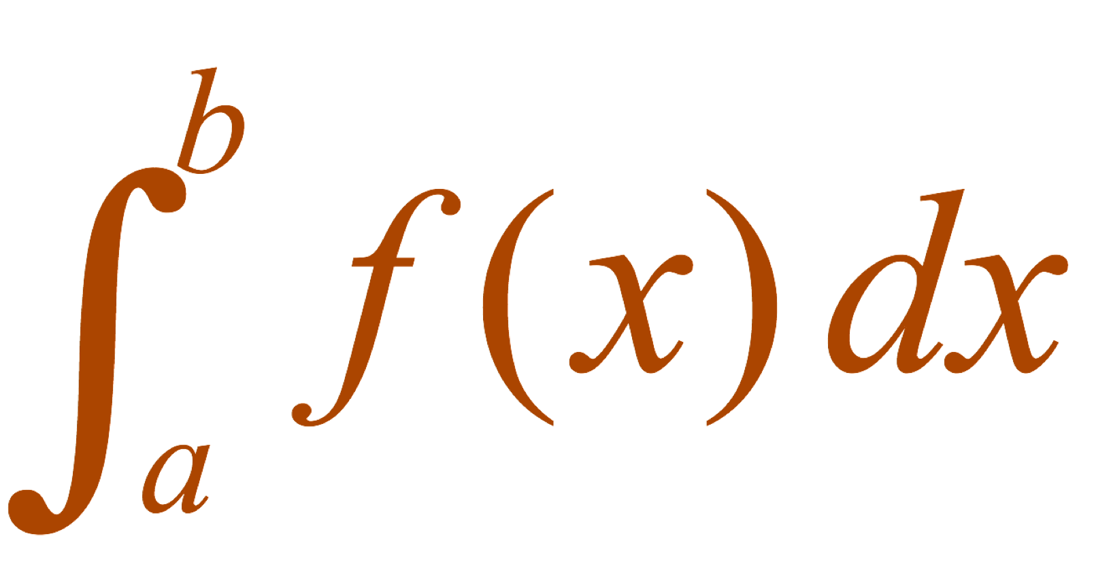
You should distinguish carefully between definite and indefinite integrals.
A definite integral is a number.
An indefinite integral is a function (or family of functions).

Slide 23
INDEFINITE VS. DEFINITE INTEGRALS
Recall from Section 3.7 that if F is an antiderivative of f on an interval I, then the most general antiderivative of f on is F(x) + C, where C is an arbitrary constant.

Slide 24
INDEFINITE VS. DEFINITE INTEGRALS
For instance,
The formula is valid (on any interval that doesn’t contain 0) because (d/dx)(– 1/x) = 1 / x².
So an indefinite integral can represent either a particular antiderivative of f or an entire family of antiderivatives (one for each value of the constant C).

Slide 25
INDEFINITE VS. DEFINITE INTEGRALS
The effectiveness of the Evaluation Theorem depends on having a supply of antiderivatives of functions.
We therefore restate the Table of Antidifferentiation Formulas from Section 3.7, together with a few others, in the notation of indefinite integrals.
Any formula can be verified by differentiating the function on the right side and obtaining the integrand. For instance,

Slide 26
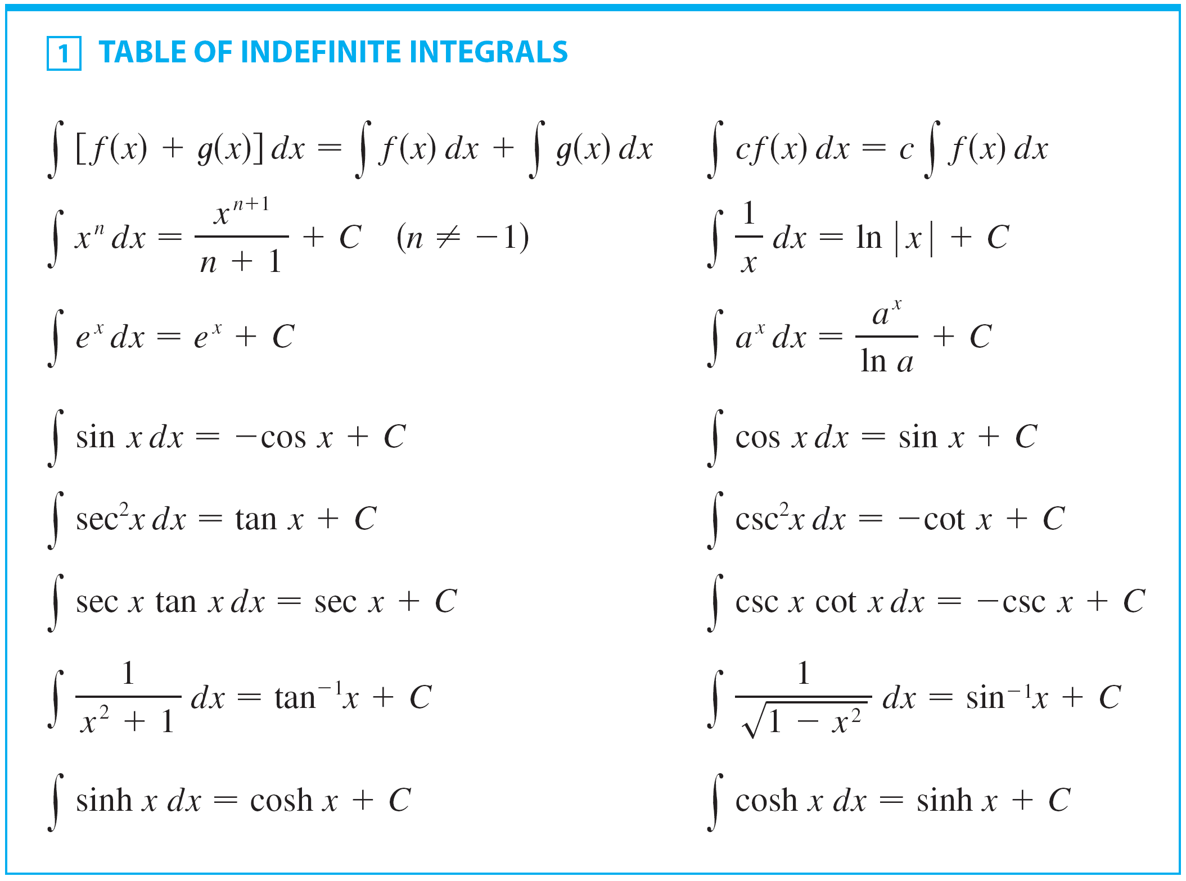
Indefinite Integrals
A Table of Antidifferentiation Formulas follows:

Slide 27
Example 3
Find the general indefinite integral
SOLUITON
Using our convention and Table 1, we have:

Slide 28
Example 3 – Solution
You should check this answer by differentiating it.

Slide 29
Example 4
Evaluate
SOLUTION
Using the Evaluation Theorem and Table 1, we have
Compare this calculation with Example 2(b) in Section 4.2.

Slide 30

Example 5
Find

Slide 31
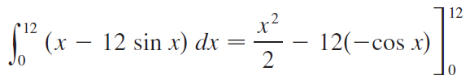



Example 5 – Solution
SOLUTION:
The Fundamental Theorem gives

Slide 32
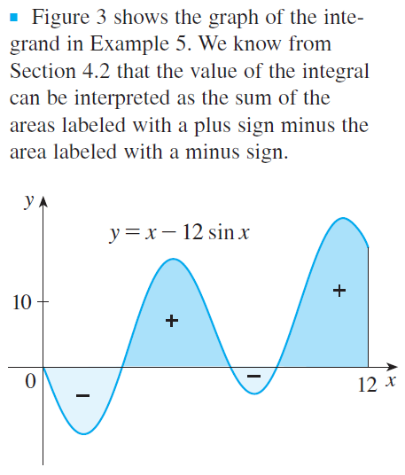

Example 5 – Solution
cont’d
We know that this is the exact value of the integral. If a decimal approximation is desired, use a calculator to approximate cos 12. Doing
so, we get
Figure 3

Slide 33
Example 6
Evaluate
SOLUTION
First, we need to write the integrand in a simpler form by carrying out the division:

Slide 34
Example 6 SOLUTION
Then,

Slide 35
Applications

Slide 36
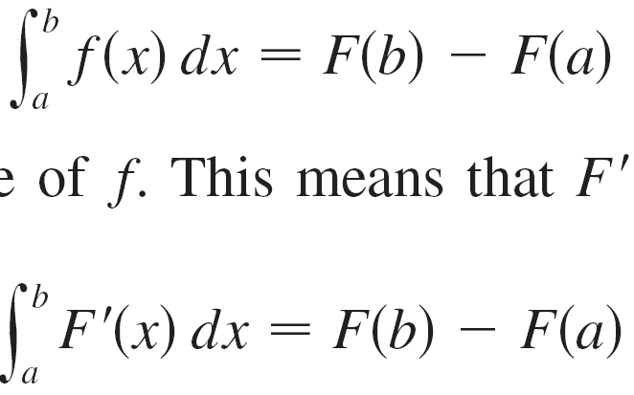
Applications
The Evaluation Theorem says that if f is continuous on [a, b], then
where F is any antiderivative of f. This means that F′ = f, so the equation can be rewritten as

Slide 37

Applications
We know that F′(x) represents the rate of change of
y = F(x ) with respect to x and F(b ) – F(a ) is the change in y when x changes from a to b.
[Note that y could, for instance, increase, then decrease, then increase again. Although y might change in both directions, F(b) – F(a) represents the net change in y.]
So we can reformulate the Evaluation Theorem in words as follows.

Slide 38
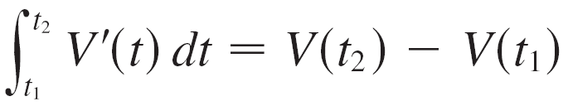
Applications
This principle can be applied to all of the rates of change in the natural and social sciences. Here are a few instances of this idea:
If V(t) is the volume of water in a reservoir at time t, then its derivative V′(t) is the rate at which water flows into the reservoir at time t.
So
is the change in the amount of water in the reservoir between time t₁ and time t₂.

Slide 39
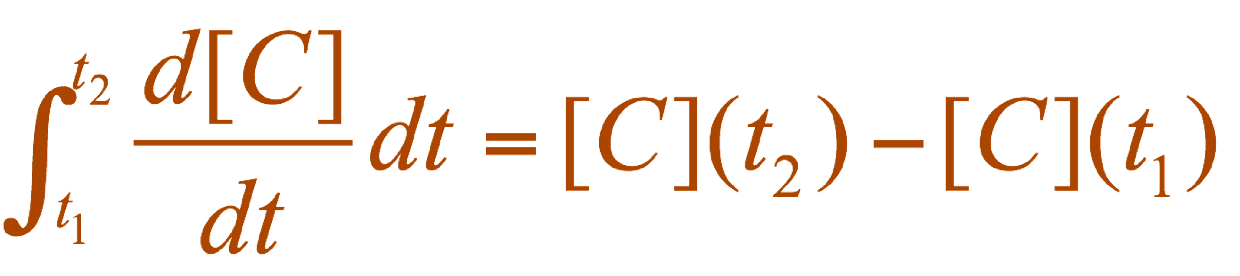
Applications
If [C](t) is the concentration of the product of a chemical reaction at time t, then the rate of reaction is the derivative d[C]/dt.
So, is the change in the concentration of C from time t₁ to time t₂.

Slide 40
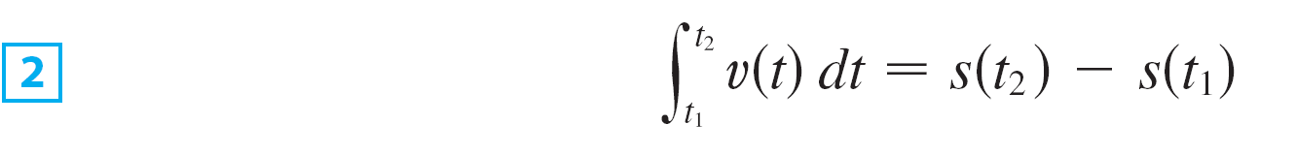
Applications
If an object moves along a straight line with position function s(t ), then its velocity is v(t ) = s′(t ), so
is the net change of position, or displacement, of the particle during the time period from t₁ to t₂.

Slide 41
Applications
In Section 4.1, we guessed that this was true for the case where the object moves in the positive direction.
Now, however, we have proved that it is always true.

Slide 42
Applications
If we want to calculate the distance the object travels during that time interval, we have to consider the intervals when:
v(t) ≥ 0 (the particle moves to the right)
v(t) ≤ 0 (the particle moves to the left)

Slide 43

Applications
In both cases, the distance is computed by integrating |v(t)|, the speed.
Therefore,

Slide 44
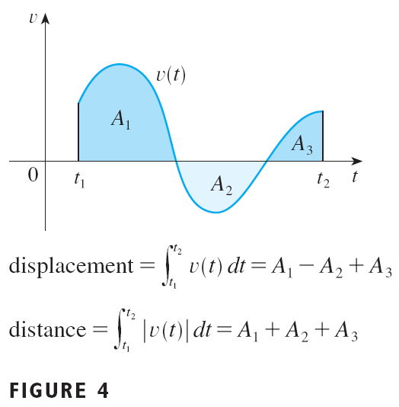
Applications
Figure 4 shows how both displacement and distance traveled can be interpreted in terms of areas under a velocity curve.

Slide 45
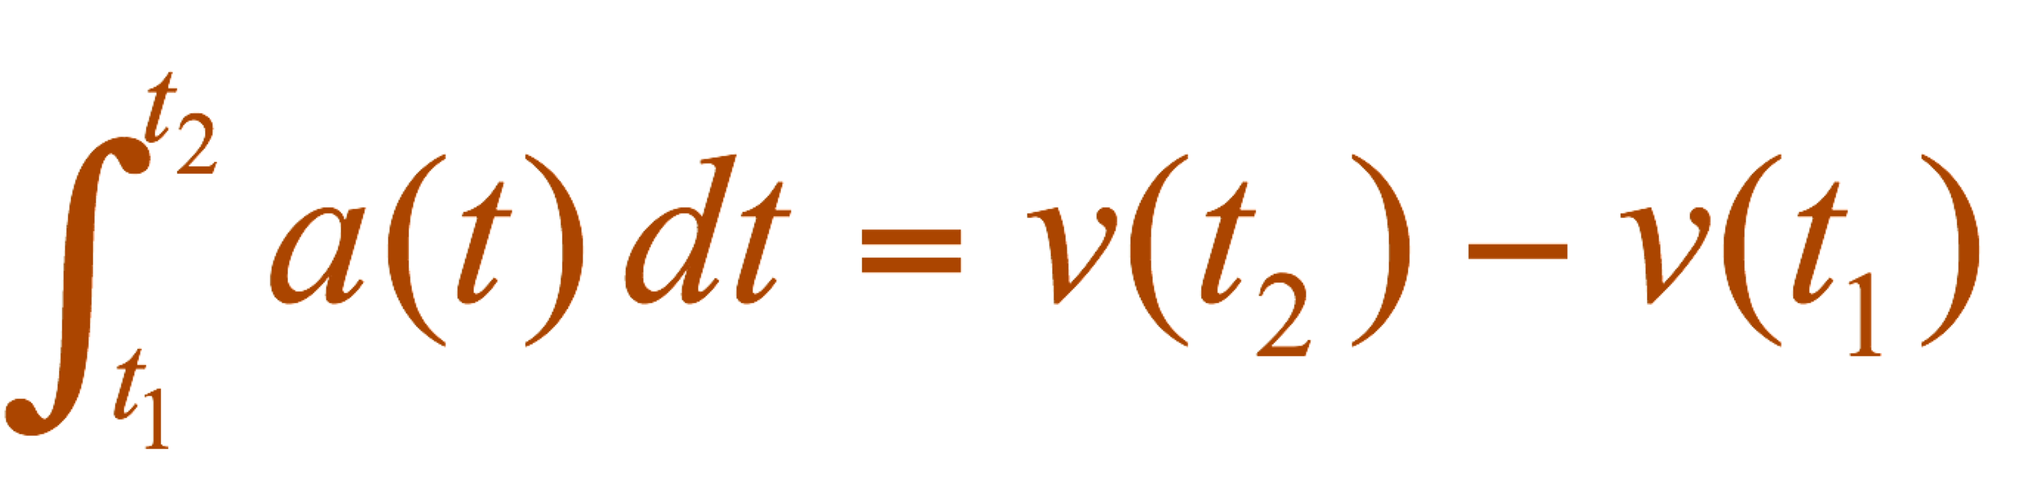
Applications
The acceleration of the object is a(t) = v’(t).
So, is the change in velocity from time t₁ to time t₂.

Slide 46
Example 7
A particle moves along a line so that its velocity at time t is v(t ) = t ² – t – 6 (measured in meters per second).
(a) Find the displacement of the particle during the time period 1 ≤ t ≤ 4.
(b) Find the distance traveled during this time period.

Slide 47
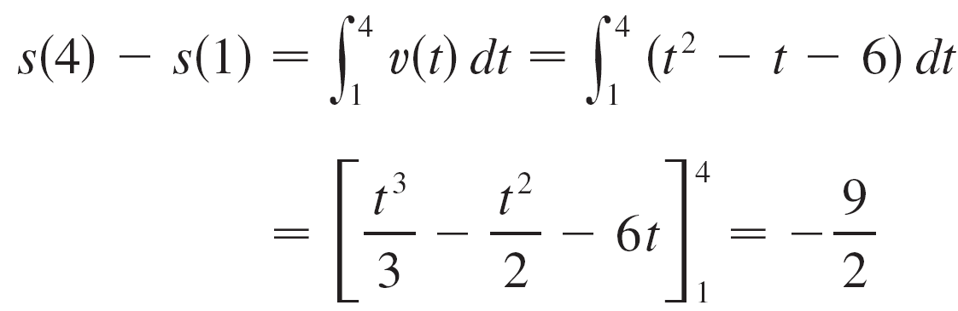
Example 7(a) – Solution
By Equation 2, the displacement is

Slide 48
Example 7(a) – Solution
cont’d
This means that the particle’s position at time t = 4 is 4.5 m to the left of its position at the start of the time period.

Slide 49
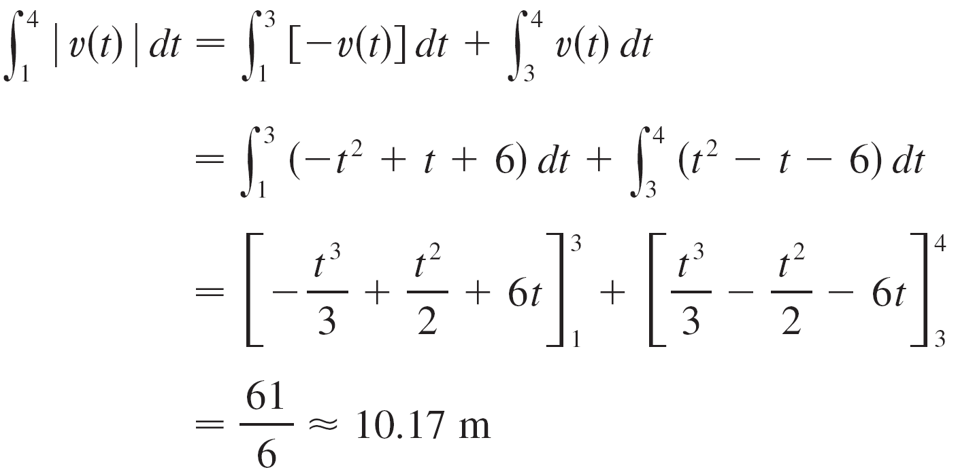
Example 7(b) – Solution
cont’d
Note that v(t) = t² – t – 6 = (t – 3) (t + 2) and so v(t) ≤ 0 on the interval [1, 3] and v(t) ≥ 0 on [3, 4].
Thus, from Equation 3, the distance traveled is

Slide 50
Example 8
Figure 5 shows the power consumption in San Francisco for a day in September.
P is measured in megawatts.
t is measured in hours starting at midnight.
Estimate the energy used on that day.

Slide 51
Example 8 SOLUTION
Power is the rate of change of energy: P(t) = E’(t)
So, by the Net Change Theorem, is the total amount of energy used that day.
We approximate the value of the integral using the Midpoint Rule with 12 subintervals and ∆t = 2, as follows.

Slide 52
Example 8 SOLUTION
The energy used was approximately 15,840 megawatt-hours.

Slide 53
NET CHANGE THEOREM
How did we know what units to use for energy in the example?
The integral is defined as the limit of sums of terms of the form P(t_{i}*) ∆t.
Now, P(t_{i}*) is measured in megawatts and ∆t is measured in hours.
So, their product is measured in megawatt-hours.
The same is true of the limit.

Slide 54
NET CHANGE THEOREM
In general, the unit of measurement for is the product of the unit for f(x) and the unit for x.

